Slide 1
PRINCIPLES OF Economics
Meaning and Concept

Slide 2
ECONOMICS – MEANING AND CONCEPT
The word Economics can be traced back to the Greek word oikonomia, which in turn is composed of two words: oikos, which is usually translated as "household"; and nemein, which is best translated as "management." Thus, the term oikonomia is referred to as the "household management”. Adam Smith was renowned as the father of economics.
Economics, by definition, is the study of wealth and resources.
The study of economics helps people understand the world around them. It enables people to understand people, businesses, markets and governments, and therefore better respond to the opportunities that emerge when things change.
The two basic branches of economics are - microeconomics and macroeconomics.

Slide 3
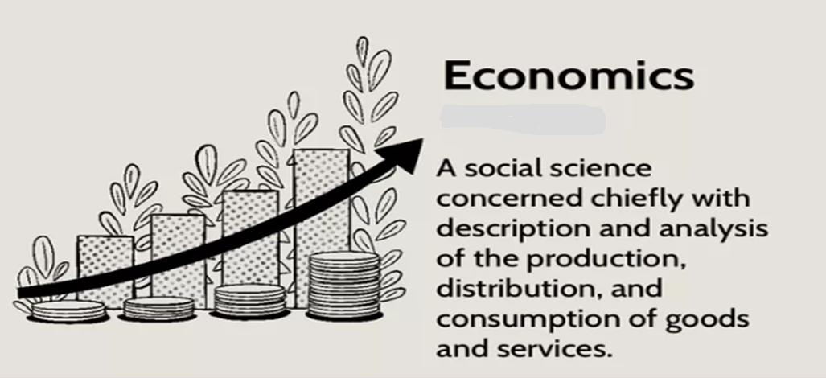
Introduction

Slide 4
BRANCHES OF ECONOMICS:
MICRO ECONOMICS
AND
MACRO ECONOMICS
(CONCEPT)

Slide 5
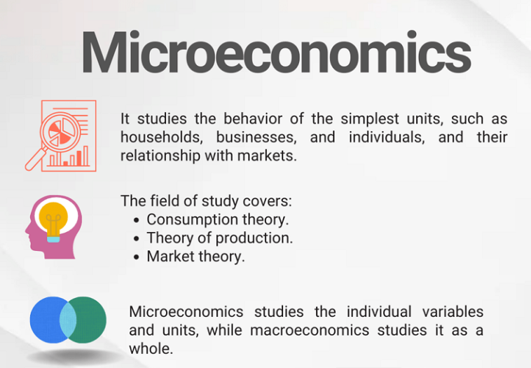
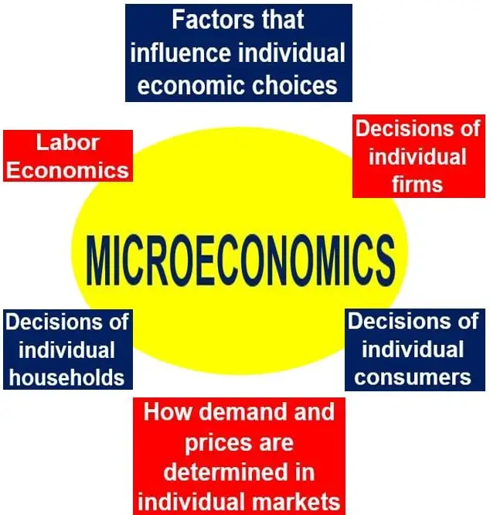
Micro Economics

Slide 6
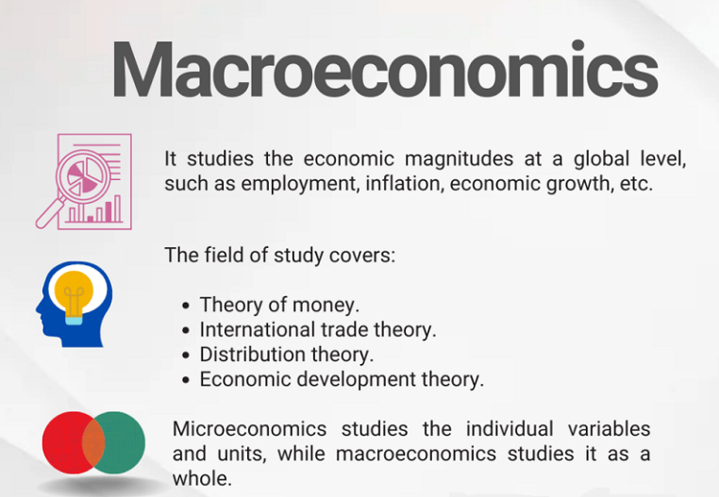
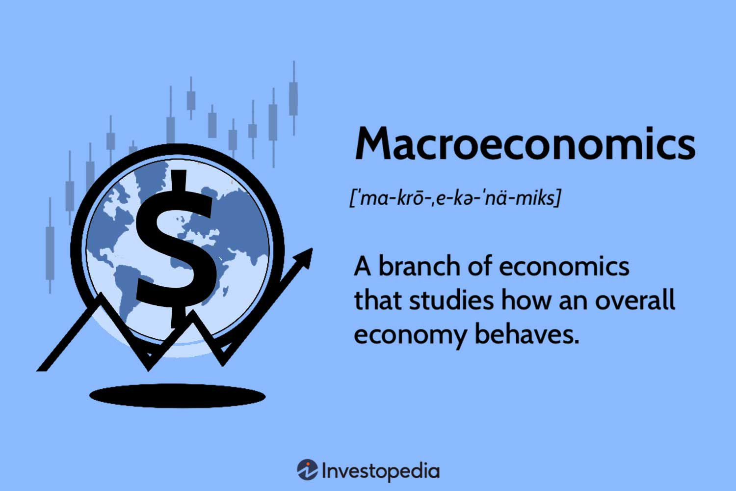
Macro Economics

Slide 7
Principle Concepts of
Economics

Slide 8
Principle Concepts to Economics

Slide 9
Scarcity Choice and
Decision-Making

Slide 10


Slide 11


Slide 12
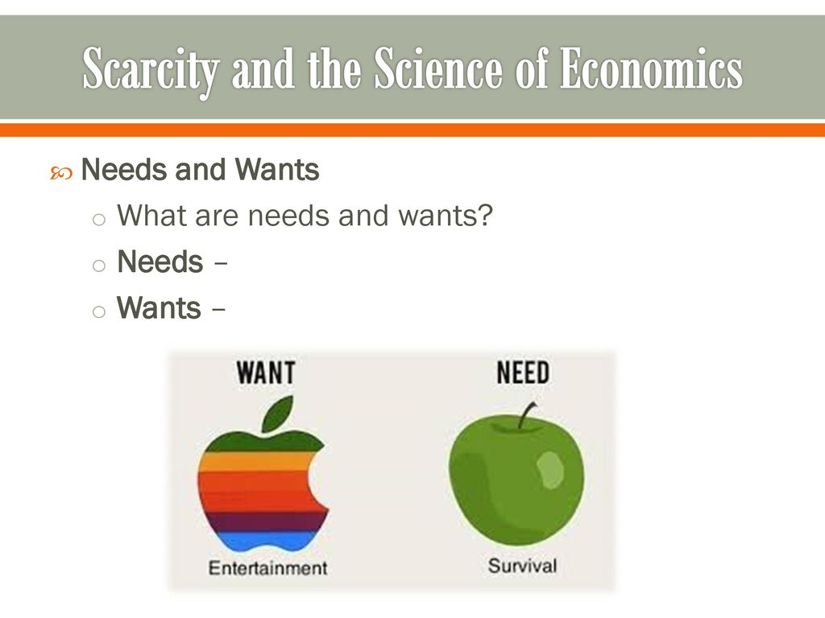

Slide 13
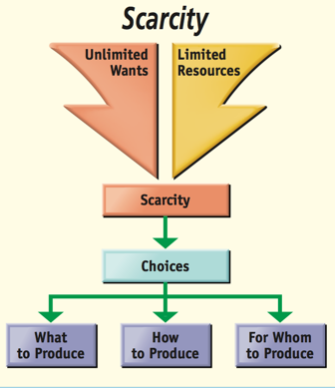
Scarcity and Choice

Slide 14
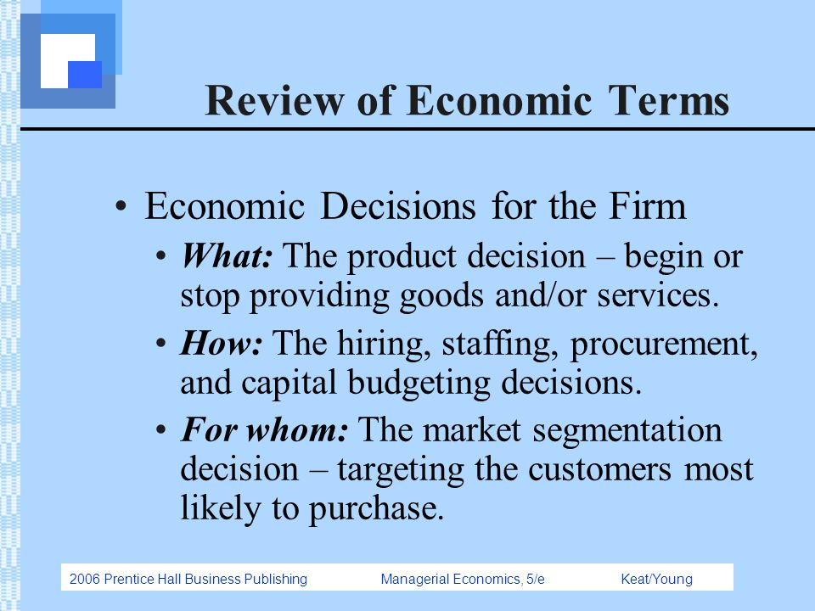

Slide 15
Why choices are important in Economics?
Choices in economics are important because resources are limited, and everyone cannot have everything they wish to have within the same period.

Slide 16
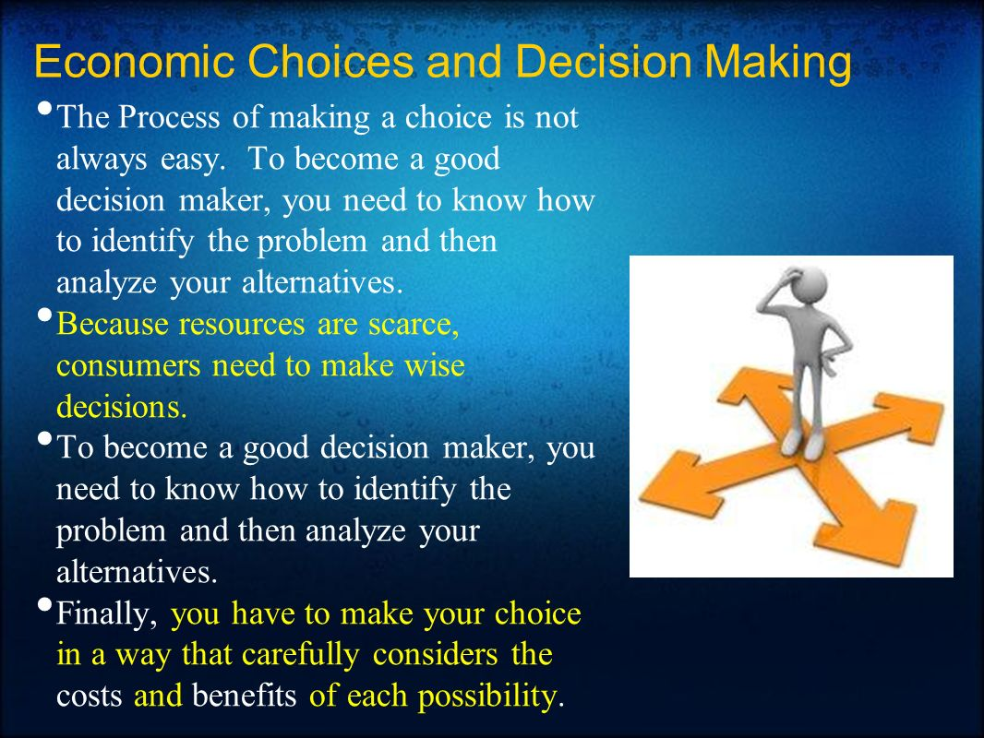
Need for choice in Decision making

Slide 17
Conclusion
Thus, to conclude it can be said that if human wants exceed the supply of resources, the scarcity problem would not be solved in society. Since the resources available to satisfy people's wants are limited in supply, so people cannot fulfill all their wants and they must make choice.

